Slide 1
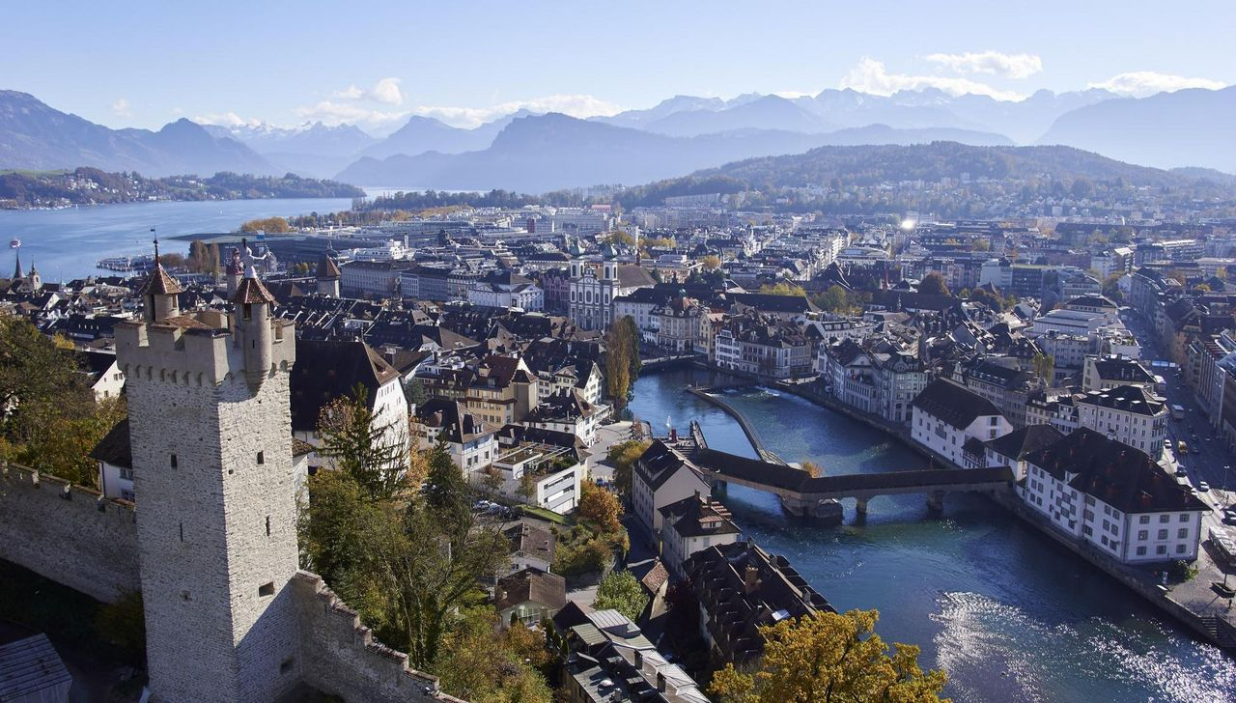
Challenge #9
GuestCard Lucerne

Slide 2
662’668
Notes:
Number of created GuestCards 2018
387‘000 were actually given to Guests
300‘000 of them were printed
There is no app!

Slide 3
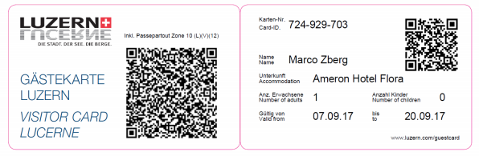
Push the GuestCard to the next level
99-99991
Hans Hansel
Schweizerhof
1
0
30.11.19
01.12.19
Intro
Results
Next steps
1
Notes:
B:
In the next 3 minutes, we will show you how to raise the guest card to the next level. guests, hotels, service providers, the tourism region of lucerne and the environment will benefit strongly from these optimizations.
C:
In the last 30 hours, we have been working intensively on optimization options for the guest card. In a very heterogeneous team with experts from the fields of economics, philosophy and tourism, we came up with a convincing solution.
Thanks to the heterogeneous team, we were able to adopt different perspectives, including the guest's perspective.
D:
What we need from you is full attention. You don't have to take notes. We have documented all results on the official hackdays page.

Slide 4
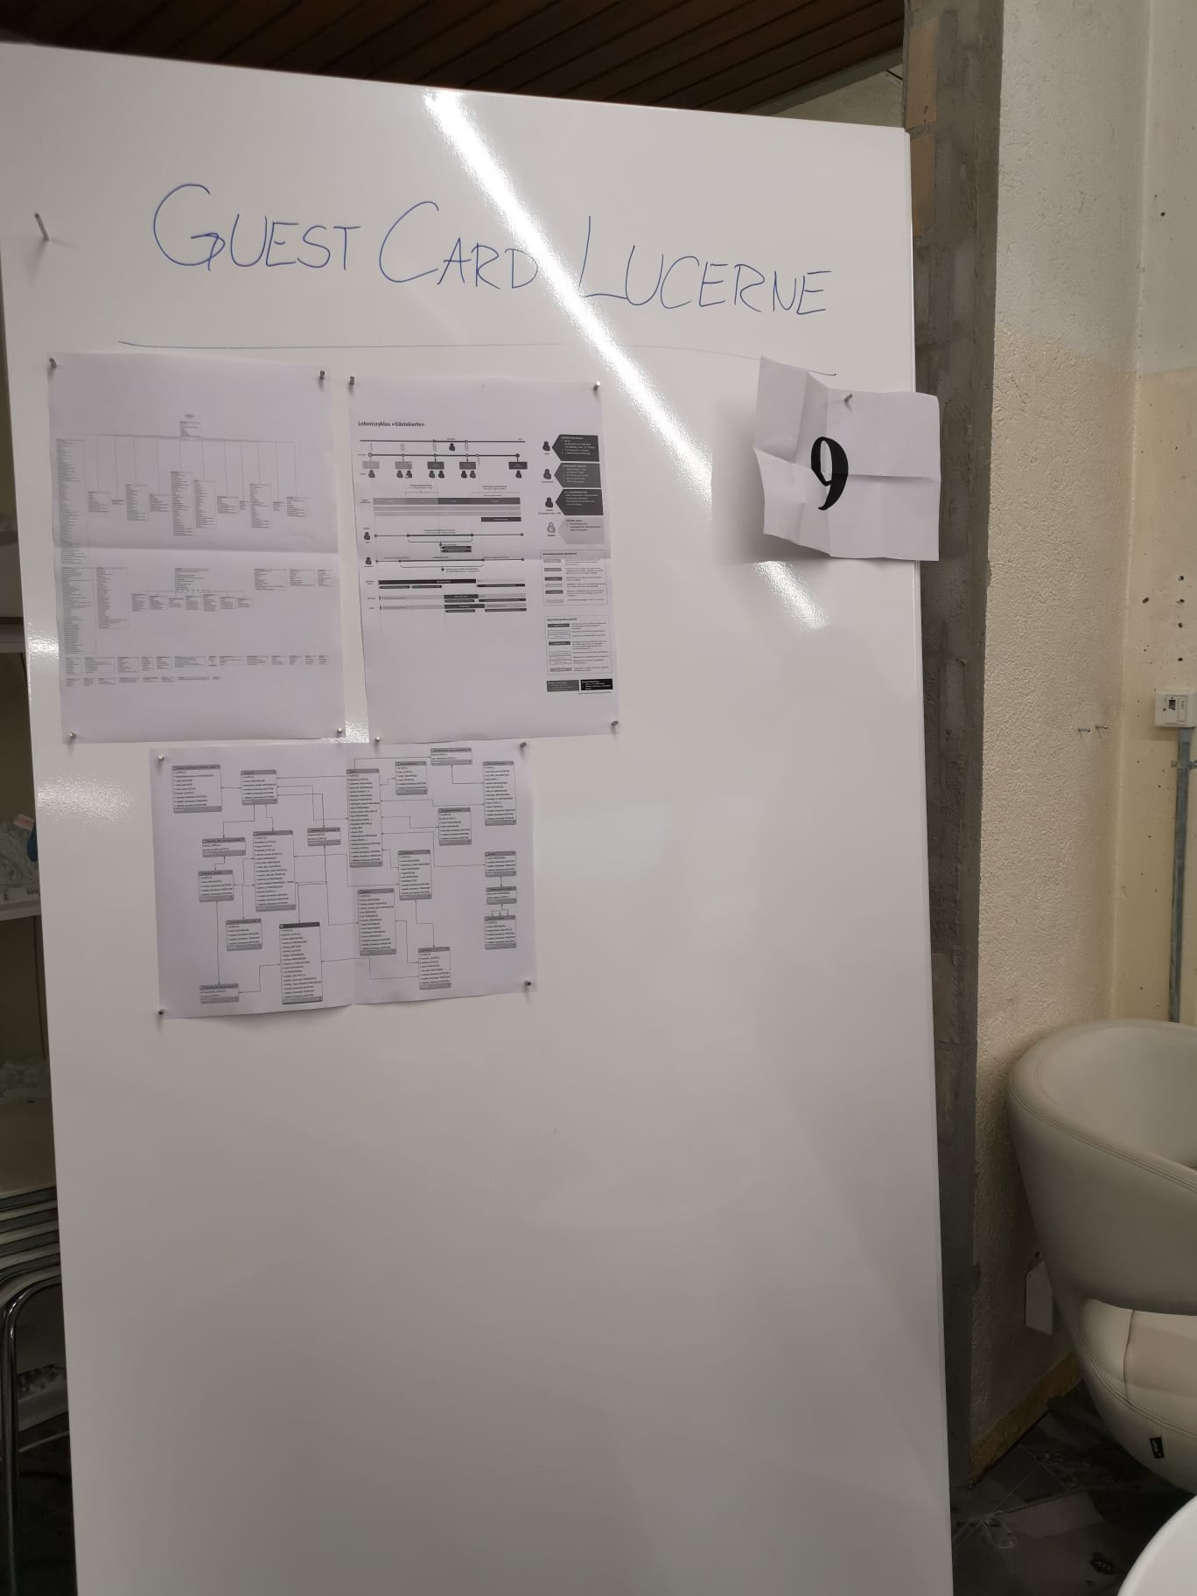
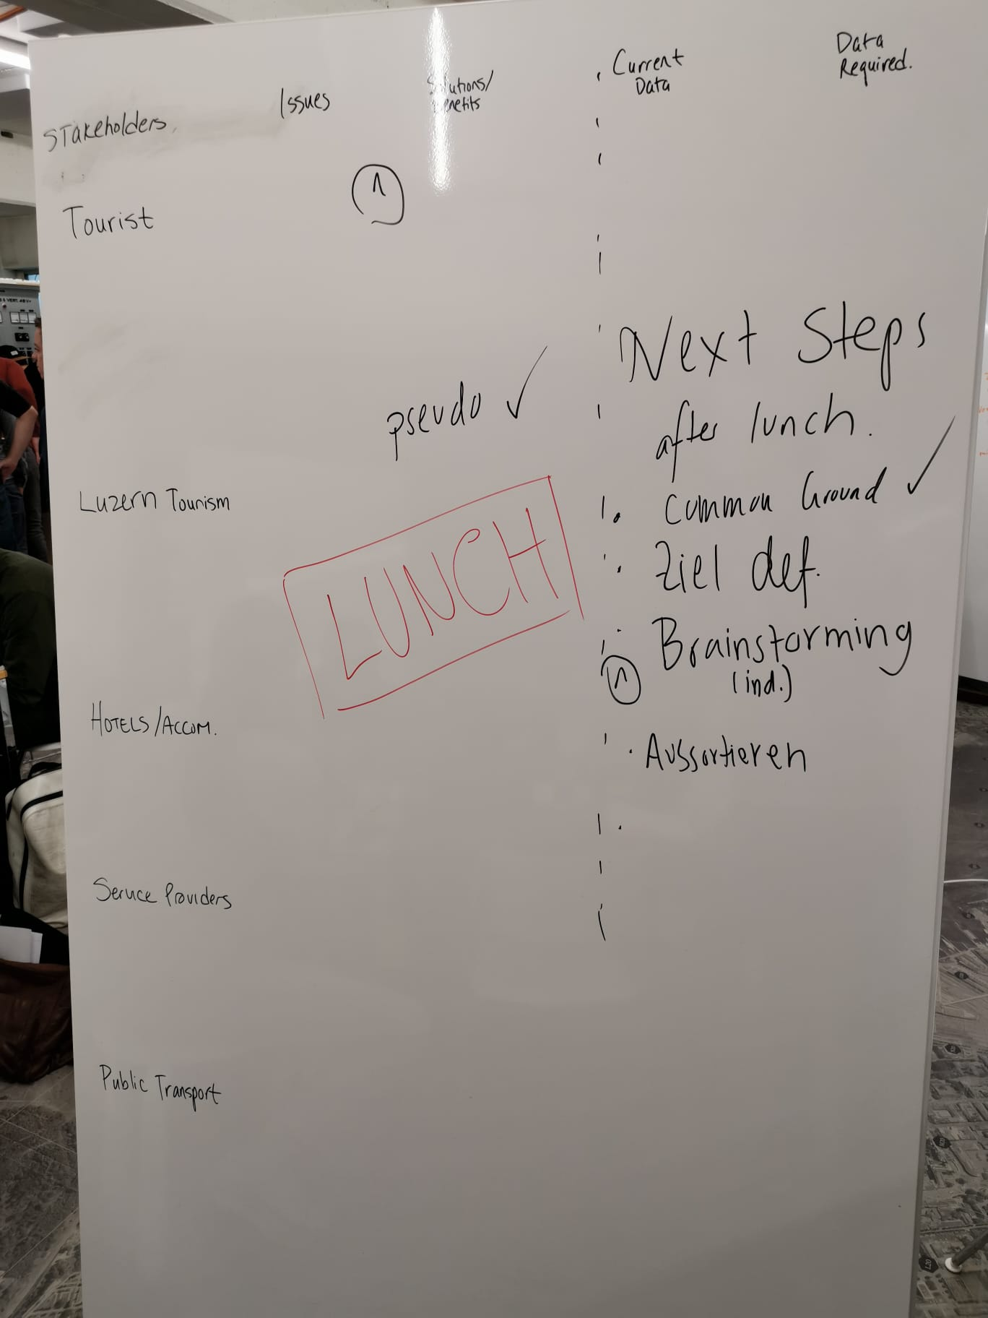
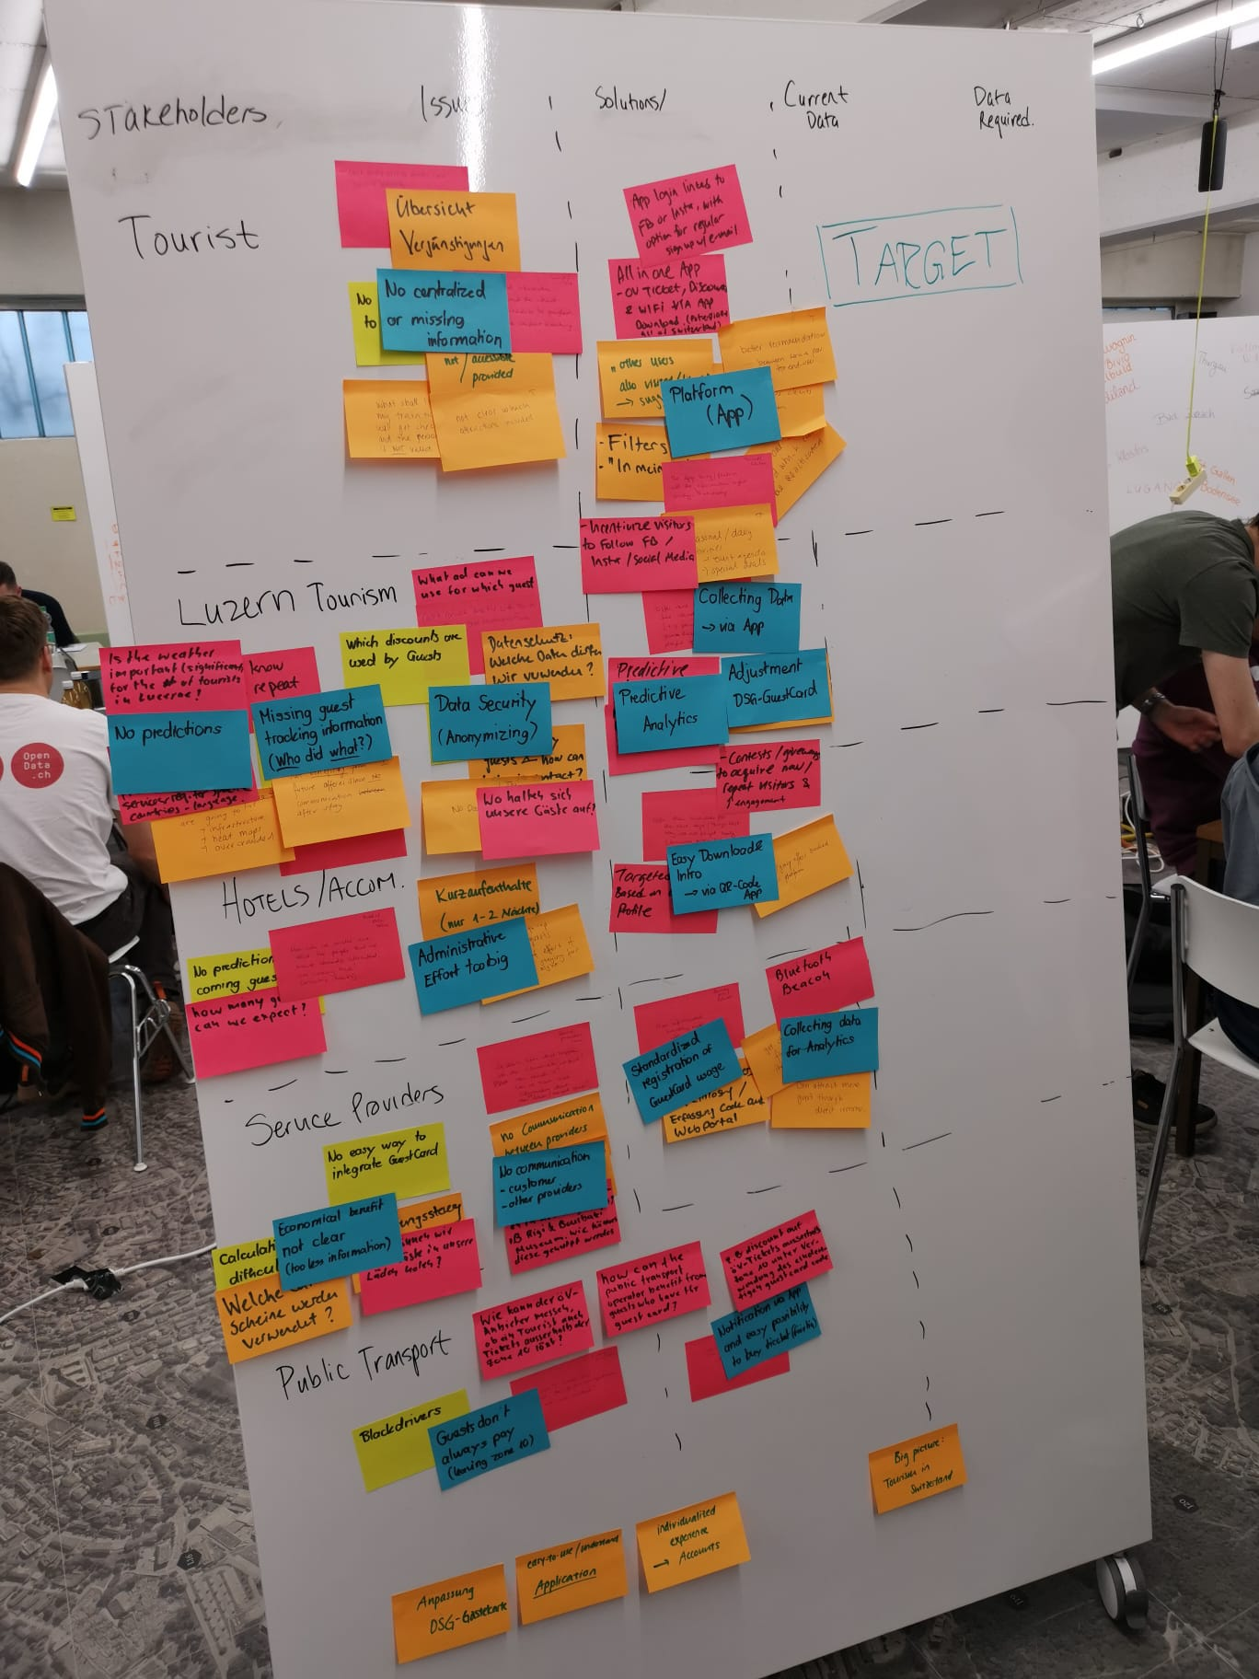
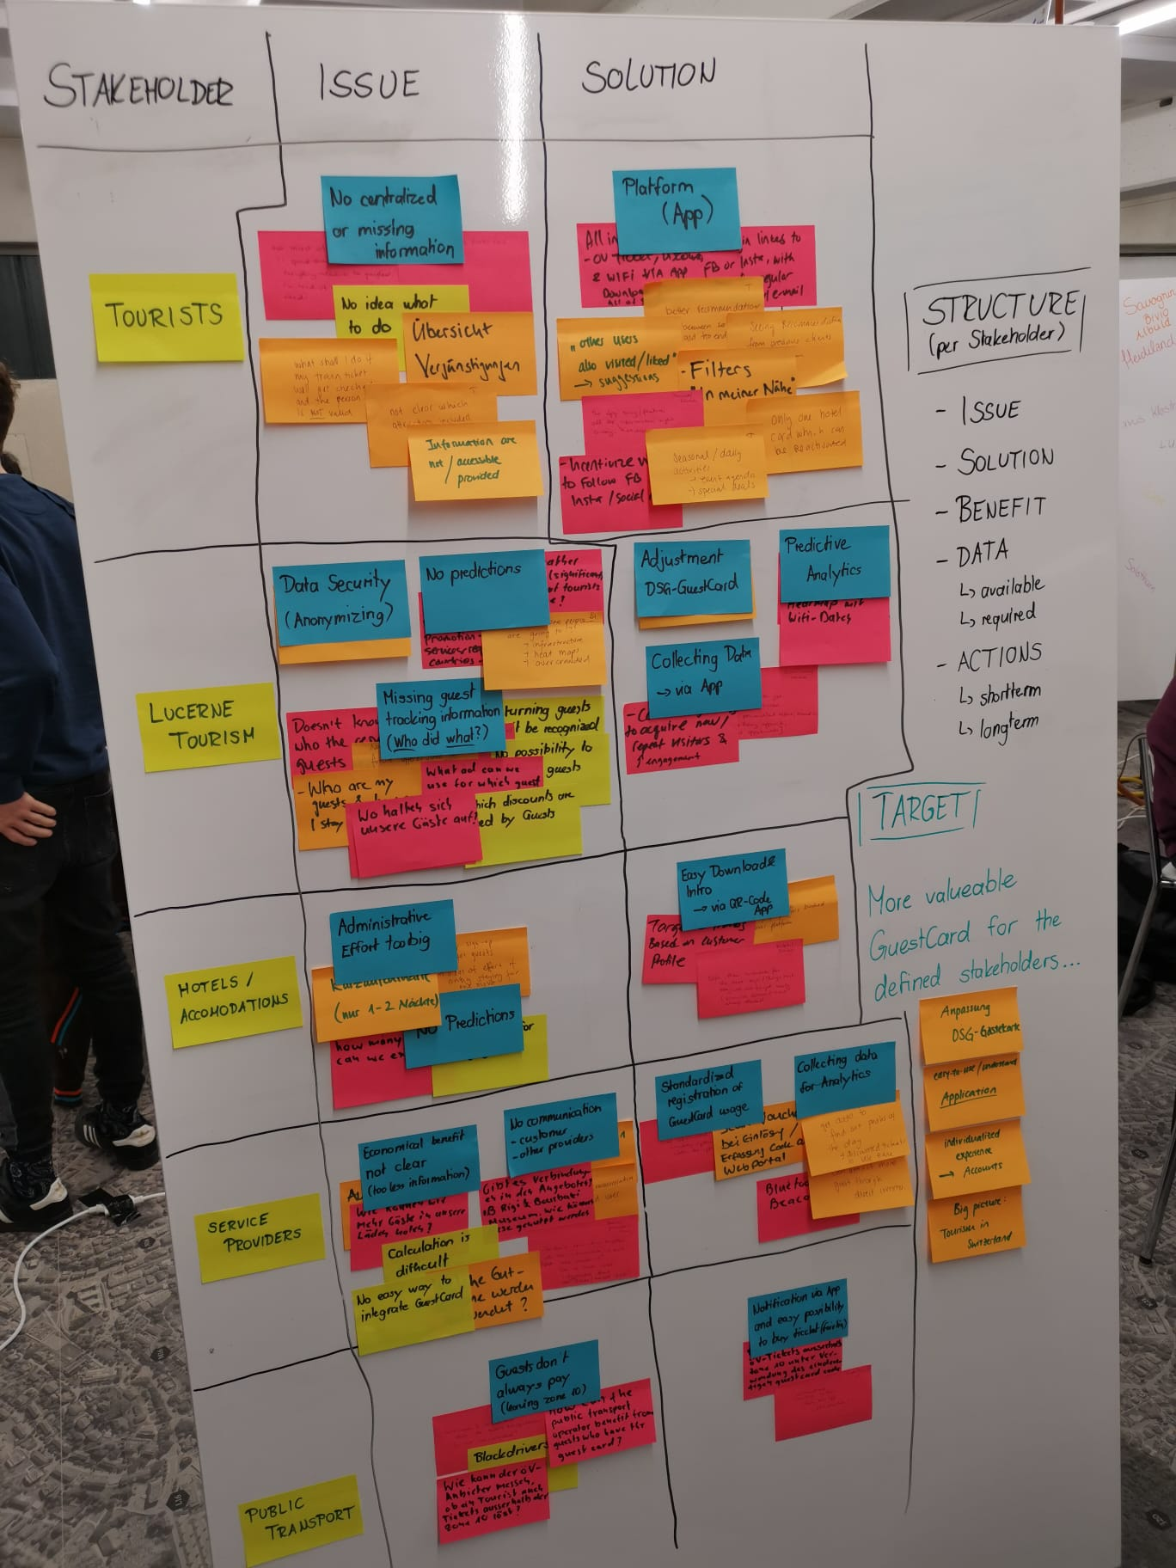
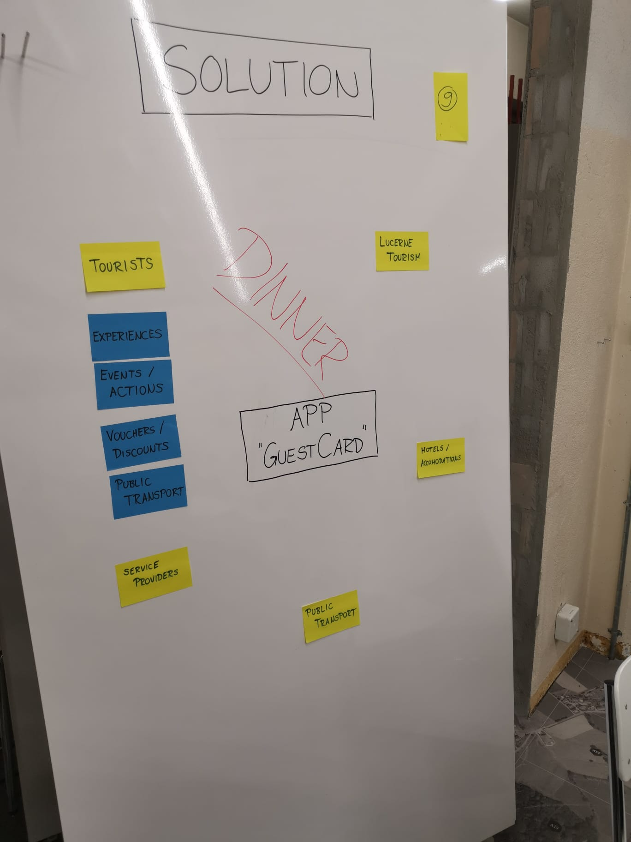
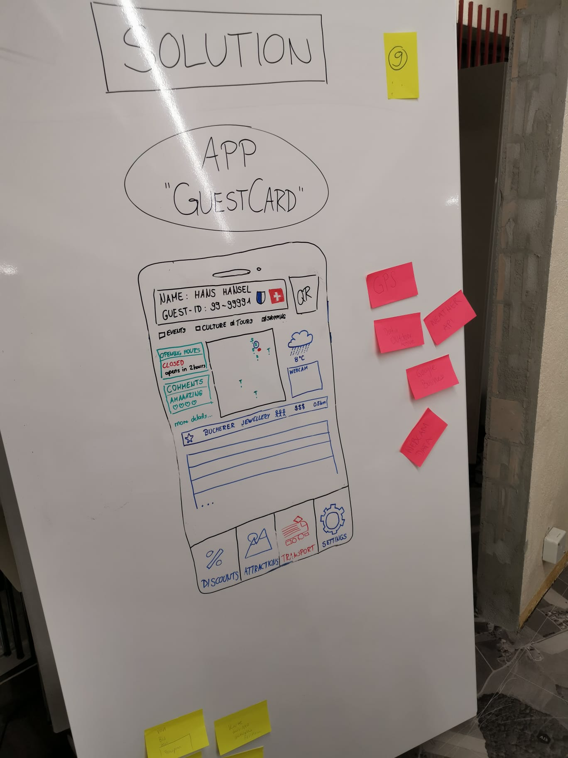
Post-Its and whiteboard markers were our friends
→ Read available documents
Intro
Approach
Results
Next steps
Notes:
B:
In the next 3 minutes, we will show you how to raise the guest card to the next level. guests, hotels, service providers, the tourism region of lucerne and the environment will benefit strongly from these optimizations.
C:
In the last 30 hours, we have been working intensively on optimization options for the guest card. In a very heterogeneous team with experts from the fields of economics, philosophy and tourism, we came up with a convincing solution.
Thanks to the heterogeneous team, we were able to adopt different perspectives, including the guest's perspective.
D:
What we need from you is full attention. You don't have to take notes. We have documented all results on the official hackdays page.

Slide 5
Post-Its and whiteboard markers were our friends
→ Create stakeholder matrix
Intro
Approach
Results
Next steps
Notes:
B:
In the next 3 minutes, we will show you how to raise the guest card to the next level. guests, hotels, service providers, the tourism region of lucerne and the environment will benefit strongly from these optimizations.
C:
In the last 30 hours, we have been working intensively on optimization options for the guest card. In a very heterogeneous team with experts from the fields of economics, philosophy and tourism, we came up with a convincing solution.
Thanks to the heterogeneous team, we were able to adopt different perspectives, including the guest's perspective.
D:
What we need from you is full attention. You don't have to take notes. We have documented all results on the official hackdays page.

Slide 6
Post-Its and whiteboard markers were our friends
→ Figure out issues and solutions
Intro
Approach
Results
Next steps
Notes:
B:
In the next 3 minutes, we will show you how to raise the guest card to the next level. guests, hotels, service providers, the tourism region of lucerne and the environment will benefit strongly from these optimizations.
C:
In the last 30 hours, we have been working intensively on optimization options for the guest card. In a very heterogeneous team with experts from the fields of economics, philosophy and tourism, we came up with a convincing solution.
Thanks to the heterogeneous team, we were able to adopt different perspectives, including the guest's perspective.
D:
What we need from you is full attention. You don't have to take notes. We have documented all results on the official hackdays page.

Slide 7
Post-Its and whiteboard markers were our friends
→ Sort and summarize issues and solutions
Intro
Approach
Results
Next steps
Notes:
B:
In the next 3 minutes, we will show you how to raise the guest card to the next level. guests, hotels, service providers, the tourism region of lucerne and the environment will benefit strongly from these optimizations.
C:
In the last 30 hours, we have been working intensively on optimization options for the guest card. In a very heterogeneous team with experts from the fields of economics, philosophy and tourism, we came up with a convincing solution.
Thanks to the heterogeneous team, we were able to adopt different perspectives, including the guest's perspective.
D:
What we need from you is full attention. You don't have to take notes. We have documented all results on the official hackdays page.

Slide 8
Post-Its and whiteboard markers were our friends
→ Define overall solution
Intro
Approach
Results
Next steps
Notes:
B:
In the next 3 minutes, we will show you how to raise the guest card to the next level. guests, hotels, service providers, the tourism region of lucerne and the environment will benefit strongly from these optimizations.
C:
In the last 30 hours, we have been working intensively on optimization options for the guest card. In a very heterogeneous team with experts from the fields of economics, philosophy and tourism, we came up with a convincing solution.
Thanks to the heterogeneous team, we were able to adopt different perspectives, including the guest's perspective.
D:
What we need from you is full attention. You don't have to take notes. We have documented all results on the official hackdays page.

Slide 9
Post-Its and whiteboard markers were our friends
→ Draw ideas of prototype
Intro
Approach
Results
Next steps
Notes:
B:
In the next 3 minutes, we will show you how to raise the guest card to the next level. guests, hotels, service providers, the tourism region of lucerne and the environment will benefit strongly from these optimizations.
C:
In the last 30 hours, we have been working intensively on optimization options for the guest card. In a very heterogeneous team with experts from the fields of economics, philosophy and tourism, we came up with a convincing solution.
Thanks to the heterogeneous team, we were able to adopt different perspectives, including the guest's perspective.
D:
What we need from you is full attention. You don't have to take notes. We have documented all results on the official hackdays page.

Slide 10




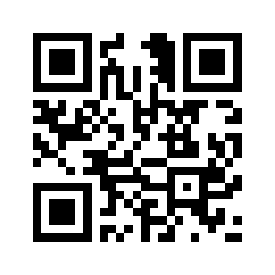





Hans Hansel’s new guest journey: Preparation
Booking
Confirmation
App / Account
QR-Code
Travelling
Activate GuestCard
Hans
Intro
Results
Next steps
2

Slide 11
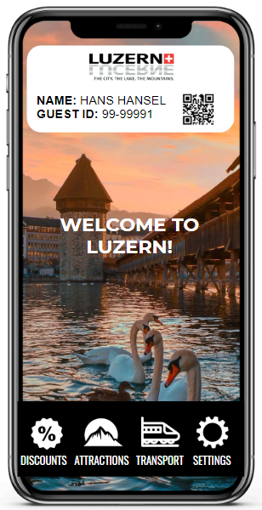
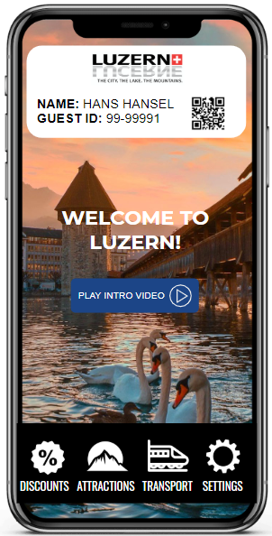




Hans Hansel’s new guest journey: Stay in Lucerne
WELCOME Page
Hotels/accommodations
Reduced administrative effort
Header with QR-Code
Intro Video
Tourist
Centralized information
Tab Discounts
Tab Attractions
Tab Transport
Tab Settings
Intro
Results
Next steps
3

Slide 12
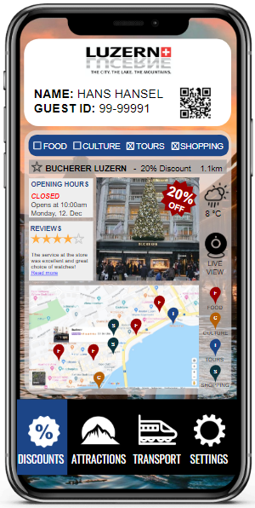
Hans Hansel’s new guest journey: Stay in Lucerne
DISCOUNTS Tab
Service providers
Direct communication and
promotion
Filters for categories
Map with pins
Service providers
Measure and optimize discount offers
List with discounts
More details…
Intro
Results
Next steps
4

Slide 13
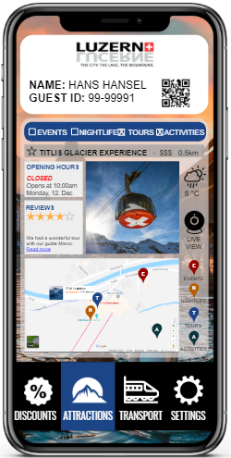
Hans Hansel’s new guest journey: Stay in Lucerne
ATTRACTIONS Tab
Lucerne Tourism
Influence activities of tourists
Filters for categories
Map with pins
Reviews
More details…
Intro
Results
Next steps
5

Slide 14
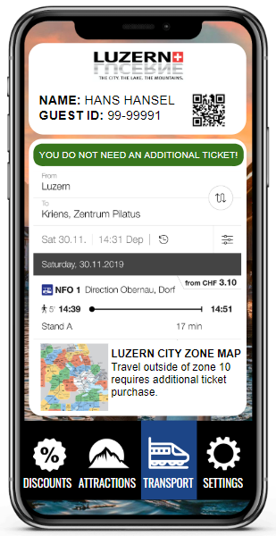
Hans Hansel’s new guest journey: Stay in Lucerne
TRANSPORT Tab
Public transport
Tourists buy correct
ticket
QR-Code as ticket
Ticket advisor
Tourist
Less fined tourists
Timetable (From – To)
Zone plan
Intro
Results
Next steps
6

Slide 15
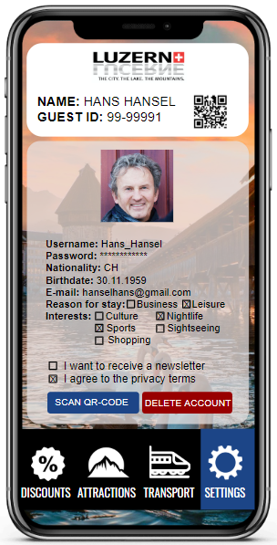
Hans Hansel’s new guest journey: Stay in Lucerne
SETTINGS Tab
Lucerne Tourism
Retain data and rebuild customer journey
Personal information
Travel reason
Lucerne Tourism
Use newsletter to stay in contact
Interests
Newsletter
Scan QR-Code
Intro
Results
Next steps
7

Slide 16
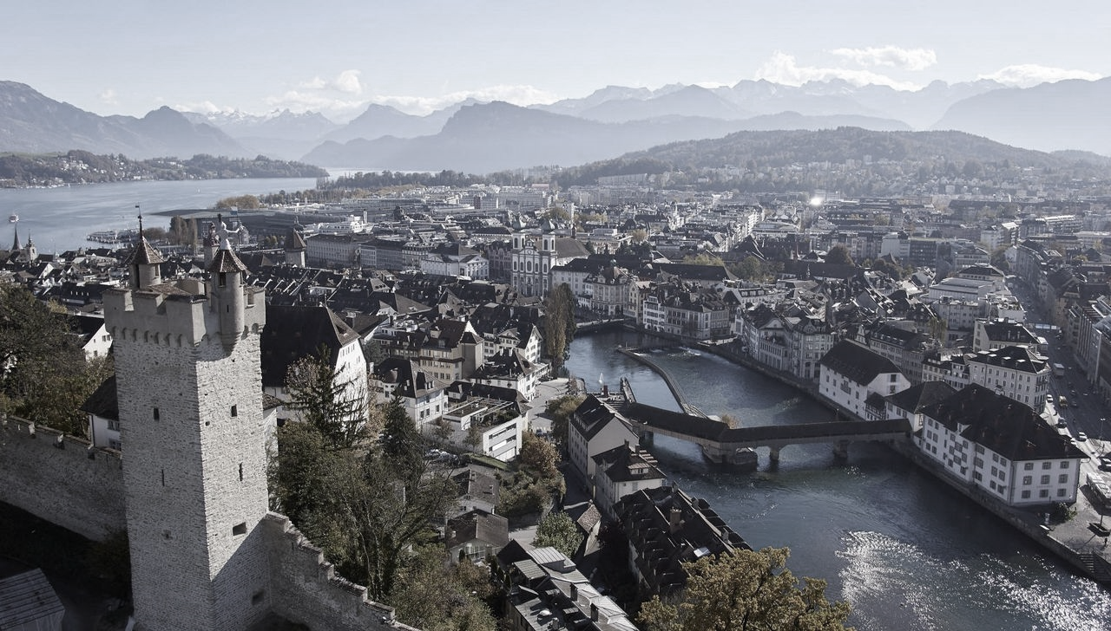
Build an app and use pseudonymizing
Lucerne
Tourism
Service
Providers
Build an app
Pseudonymize data
Onboard other stakeholders
Create app content
662‘668
Hotels/
Accommodations
Public
Transport
Intro
Results
Next steps
8

